Slide 1

SocialX

Slide 2



PROBLEMS
Lack of privacy and data control on existing platforms
Centralized control of user data and content.
Limited monetization opportunities for content creators

Slide 3

SOLUTIONS
Decentralized platform for user data privacy and control.
Transparent, tamper-proof content management.
Enabling direct peer-to-peer monetization for creators

Slide 4
KEY FEATURES
Blockchain-based identity and data management.
Smart contract-driven monetization for content creators.
Community governance for decision-making

Slide 5
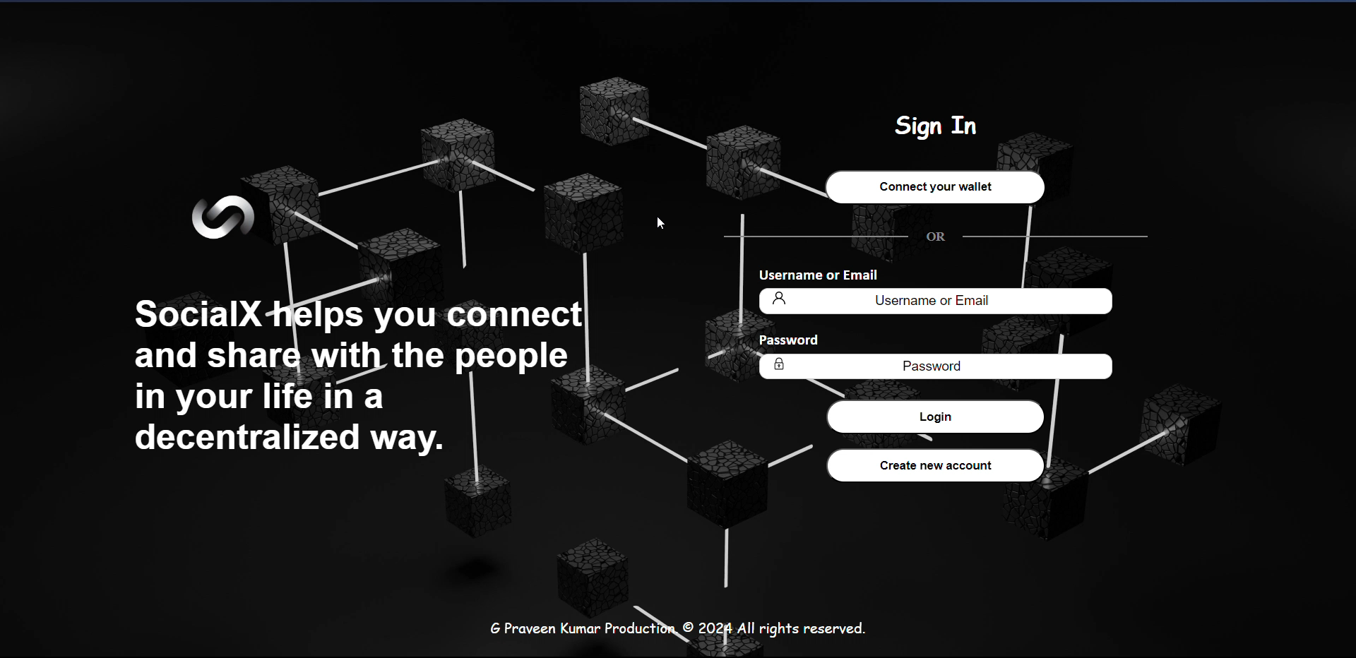

Slide 6
PROB
SocialX
Empowering Social Interactions
with Blockchain

Slide 7
IMMUTABLE MINDS
By:

